Slide 1
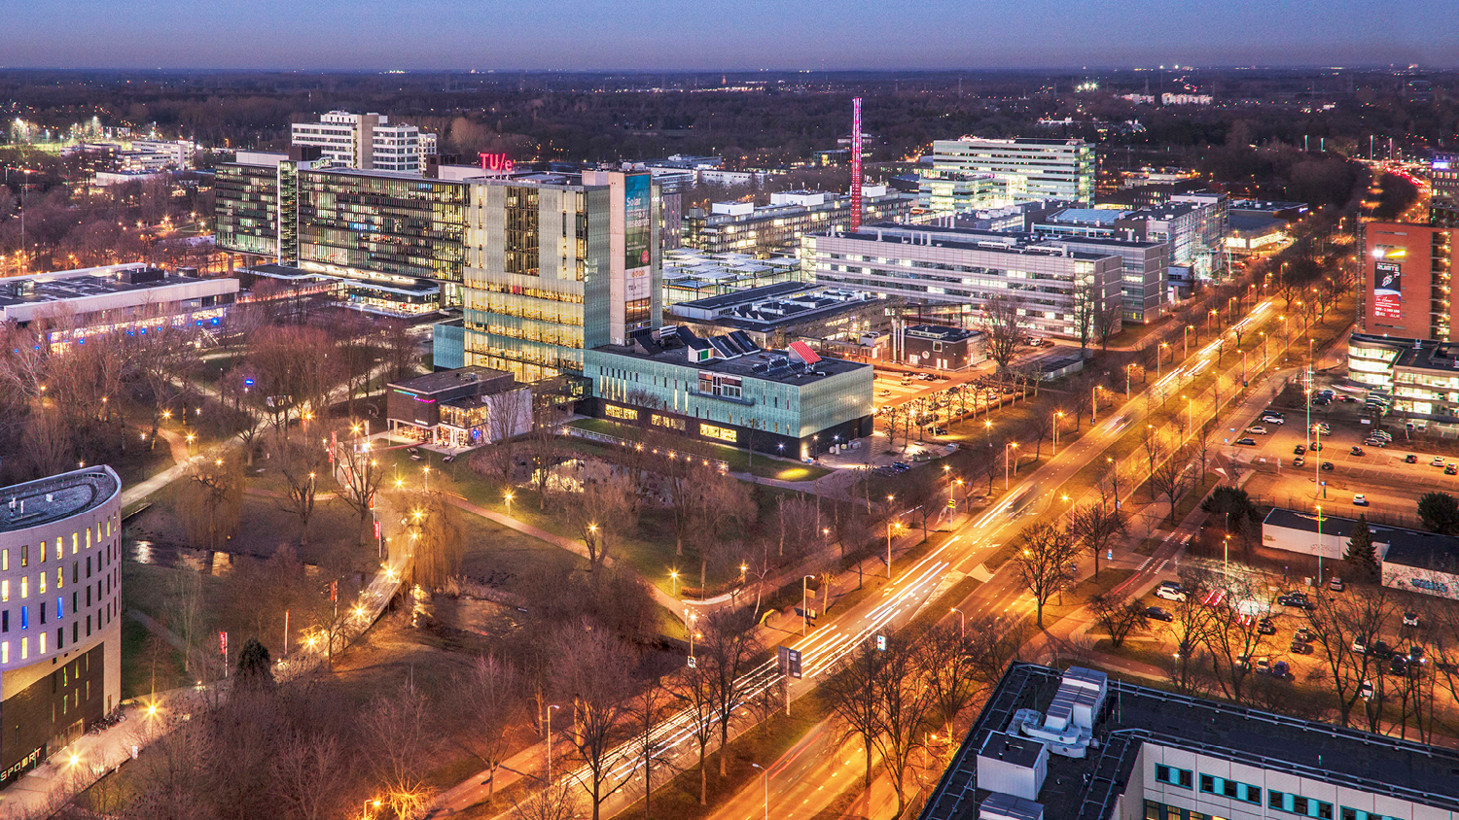
Counterfactual Inference on Retina Fundus Images using Deep Structural Causal Models
12/12/2022
Speaker: Shiqi Liao
Supervisor: Prof. Vlado Menkovski, Prof. Mitko Veta, Msc. Minartz Koen
Mathematics and Computer Science, Data Science in Engineering, Data Mining

Slide 2
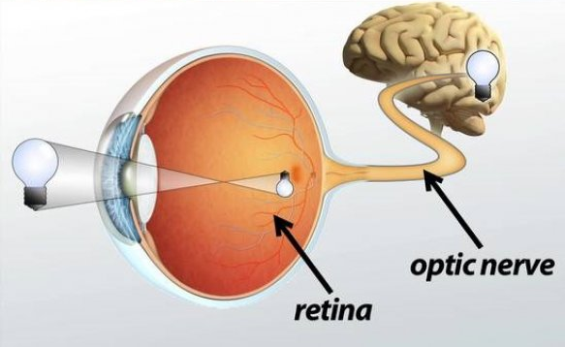
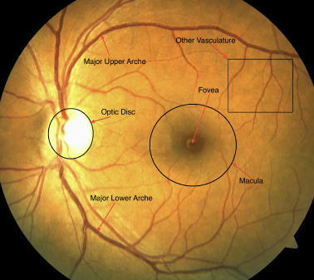
Background -> retina and fundus image
Fig 1: Retain and Brain
Fig 2: An example fundus image
Notes:
Retina is a tissue layer within our eyes and connects with the brain.
retina color fundus image is a common colorful retina photograph.
We can see anatomical structures like vessel and optic disc from the fundus image

Slide 3
Background -> limitations in explanation
Fig 3: Unexplained causal relationship between fundus images and patient attributes

Slide 4
Background -> limitations in explanation
Fig 4: Generate fundus images conditioned on patient attributes
Notes:
A novel method for explanation:
generate fundus images conditioned on patient attributes.
Compare the fundus images generated under different values of the same patient attribute
Deduce the relationship between the patient attributes and fundus images.
To generate fundus images for an individual observation conditioned on the patient attribute that is not real for him.
I want to know what my fundus image would look like when I was 80 years old.
To generate such image, we adopt the Deep Structural Causal Models

Slide 5
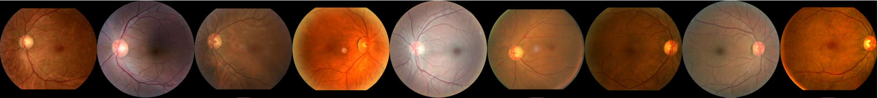
Background -> limitations in explanation
Confounding between patient attributes
Fundus image appearance is variant
Fig 5: Causal graph
Fig 6: variant fundus image appearance
Notes:
Confound means that When we study the correlation between two independent variables, there is a common cause on them, this common cause falsely demonstrate the correlation. For example, aging causes people to have diabetes and it changes the fundus image appearance. So are deep learning predicting the diabetes by the correlation via age or the causal impact from diabetes on fundus image?
A generative model on correlation cannot solve this problem.
Another limitation is that fundus image appearance is variant. Everyone has different color, location of optic disc and vessel shape. So we cannot tell whether the difference between two generated fundus images is for the variation or the conditioned patient attribute.

Slide 6
Motivation
Construct a Deep Structural Causal Model to quantitively model the causal relationships between patient attributes and fundus images.
Generate counterfactual inferred fundus images.
-“what your fundus image would look like when you were 80 years old?”
Fig 7: eliminate causation from age on diabetes in a causal graph
Notes:
Gengerate 解释清除 counterfactual
o mitigate these two limitations, we construct a causal model named deep structural causal model. It uses deep learning to quantitively model the causal relationship between patient attributes and fundus images. And we can generate data for each variables in the system based on its causes.
How do we solve the limitation, for confounding, when we generate the fundus images conditioned on diabetes, we eliminate the causation from age on diabetes.
In this way, we model the causal impact from diabetes on fundus image.
For the variation in fundus image appearance, we want to generate fundus image with the variation of the fundus images reserved. For example, we can model what your fundus image would look like when you were 80 years old. This is named counterfactual inferred fundus images.

Slide 7
Research question
What are the causal relationship between patient attributes and fundus image?

Slide 8
Methodology -> Assumed causal graph
Fig 8: Assumed causal graph
Notes:
Firstly, we demonstrate the assumed causal graph. We use the nodes to represent the variables and use the arrows to represent the causal relationship from the cause to the effect. And we call the cause the parent variable of the effect.
In our assumption, we assume gender and age, cause diabetes status and fundus images respectively. And the diabetes status causes the fundus image. And we can see that gender and age are two confounders on the relationship between diabetes status and fundus images.

Slide 9
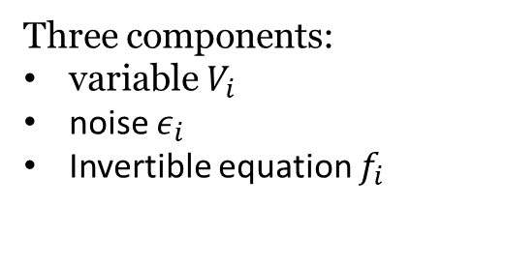
Methodology -> DSCM(Deep Structural Causal Model)
Three components:
variable $V_{i}$
noise $ε_{i}$
Invertible equation $f_{i}$
$$V_{i}:=f_{i}\left(ε_{i};Pa\left(V_{i}\right)\right)$$
Fig 8: Assumed causal graph
Fig 9: custom DSCM
Notes:
So based on the assumed causal DAG, we design the deep Structural Causal Model.
It includes the variable gender, diabetes status, age and fundus image
And we design an invertible structural equation for diabetes status, age and fundus image.
The invertible structural equation is a bijective mapping from the variable to its parent variable and its noise.
The noise $ε_{i}$ accounting for unobserved factors that causes the variable. For example, the diabetes status, the noise $ε_{d}$ accounts for the unobserved factors like fat, gene that causes diabetes.

Slide 10
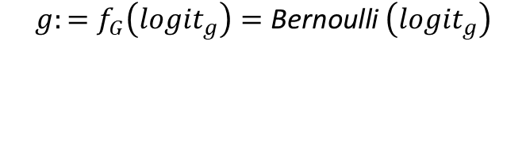
Methodology -> Gender
$$g:=f_{G}\left({logit}_{g}\right)=\text{B}\text{e}\text{rnoulli} \left({logit}_{g}\right)$$
Notes:
For binary parent variable gender, we assume it follows Bernoulli distribution with a fixed parameter logit_g.
And we learn the ${logit}_{g}$ by maximizing the likelihood of the data sample.

Slide 11
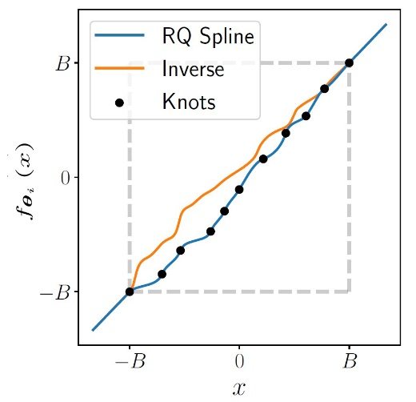
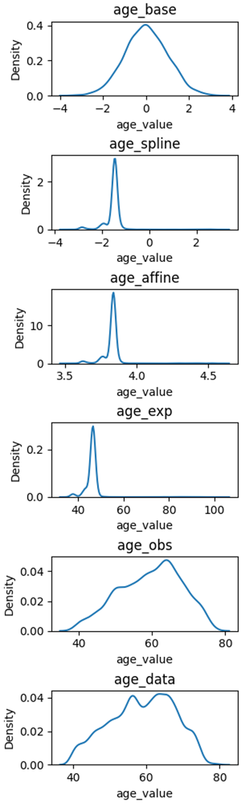
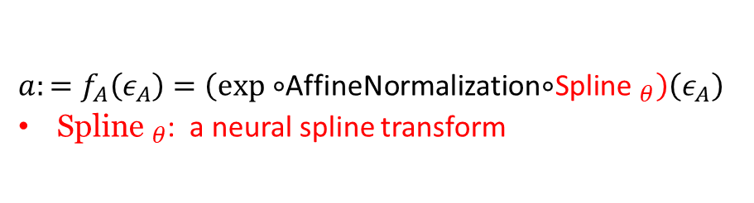
Methodology -> Age
$a:=f_{A}\left(ε_{A}\right)=\left(exp∘\right.$AffineNormalization$∘$Spline$\left. _{θ}\right)\left(ε_{A}\right)$
${\text{Spline} }_{θ}$: a neural spline transform
Unknown complex target distribution
Known simple base distribution
Fig 10: example neural spline transform
Notes:
Unknown know ratget
For discreet parent variable age, we adopt a deep learning model, neural spline transform here to estimate the target distribution of age.
A neural spline transform is a bijective map from a simple base distribution to a more complex target distribution. How does it achieve it? Basically, the transformation is composed of a set of monotonically increasing splines. Each spline is determined by knots at the endpoints and the gradient at the knots. We can optimize the location of knots and gradients by maximizing the likelihood of the data sample in the target distribution.

Slide 12
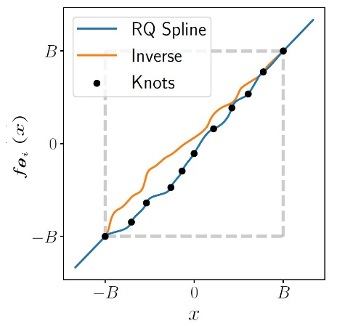
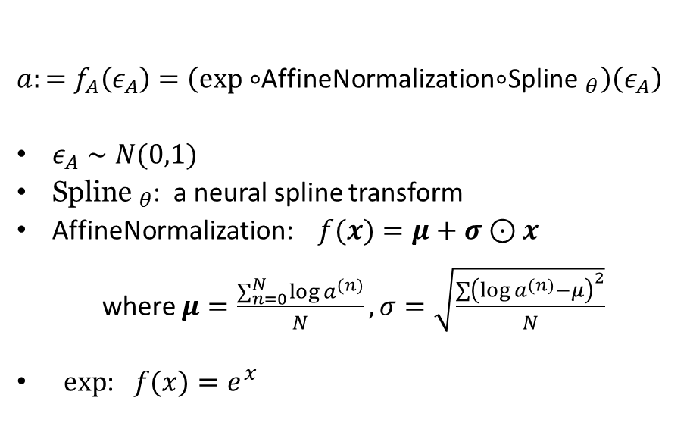
Methodology -> Age
$a:=f_{A}\left(ε_{A}\right)=\left(exp∘\right.$AffineNormalization$∘$Spline$\left. _{θ}\right)\left(ε_{A}\right)$
$ε_{A}∼N(0,1)$
${\text{Spline} }_{θ}$: a neural spline transform
AffineNormalization: $f(x)=μ+σ⊙x$
where $μ=\frac{∑_{n=0}^{N} log⁡a^{(n)}}{N},σ=\sqrt{\frac{∑{\left(log⁡a^{(n)}−μ\right)}^{2}}{N}}$
$exp$: $f(x)=e^{x}$
Fig 10: example neural spline transform
Notes:
For discreet parent variable age, we use the neural spline transform to map from Normal distribution to a complex intermediate distribution. Then we use the follow-up fixed affinenormalizaiton and exponential transformation to map the intermediate distribution to the distribution of age. As all transformations are bijective, the structural equation is a bijective map from $ε_{A}$ and variable age.

Slide 13
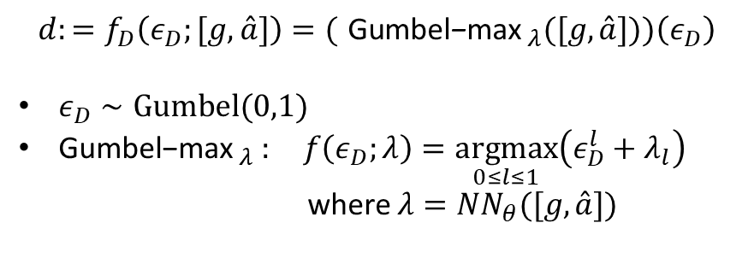
Methodology -> Diabetes status
$$d:=f_{D}\left(ε_{D};[g,\overset{ˆ}{a}]\right)=({ \text{Gumbel}\text{−}\text{max} }_{λ}([g,\overset{ˆ}{a}]))\left(ε_{D}\right)$$
$ε_{D}∼Gumbel⁡(0,1)$
${\text{Gumbel}\text{−}\text{max} }_{λ }: f\left(ε_{D};λ\right)=\underset{0≤l≤1}{argmax}\left(ε_{D}^{l}+λ_{l}\right)$
where $λ=NN_{θ}([g,\overset{ˆ}{a}])$
Notes:
For categorical variable diabetes status, It has parent variable gender and age. the noise e_d follows Gumbel distribution. So that we can use the Gumbel-Max distribution to approximate the distribution of diabetes status. Each category L has a noise e_d and the the conditional likelihood lambda. It is the likelihood of diabetes status given its parent gender and age. We use a neural network to predict it. The Gumbel-max distribution sample the argmax from the sum of them.
In this way, we map from noise and its parent variable to the diabetes status.

Slide 14
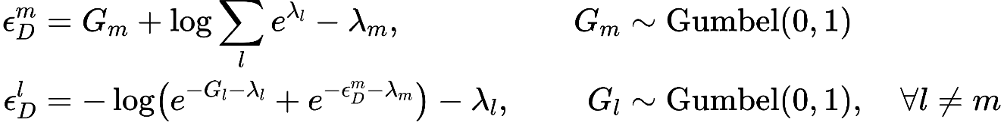
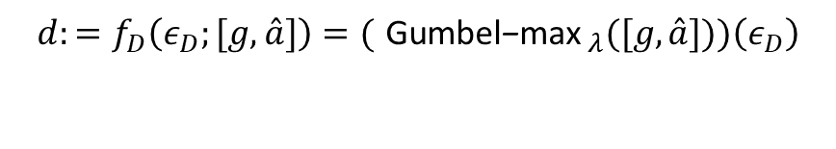
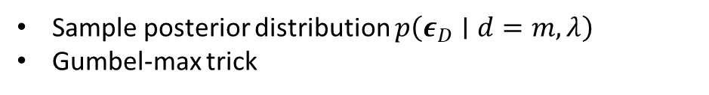
Methodology -> Diabetes status
$$d:=f_{D}\left(ε_{D};[g,\overset{ˆ}{a}]\right)=({ \text{Gumbel}\text{−}\text{max} }_{λ}([g,\overset{ˆ}{a}]))\left(ε_{D}\right)$$
Sample posterior distribution $p\left(ε_{D}∣d=m,λ\right)$
Gumbel-max trick
Notes:
For the mapping from variable diabetes status and the noise, we sample the posterior distribution like this.
Assumed the observed diabetes status is m, its noise e_d can be computed like this ,we sample another Gumbel noise G_m, add the log sum of exponential conditional likelihood of other categories, and then minus the conditional likelihood of the observed diabetes status m.
And a similar way for the noise for other categories.
The Gumbel-max trick have the advantage counterfactual stability. Counterfactual stability means that based on the resampled noises would still generate the same observed outcome if the conditional likelihood lambda is the same. And only when the conditional likelihood of other category increased faster than the observed category can it generate other category.

Slide 15
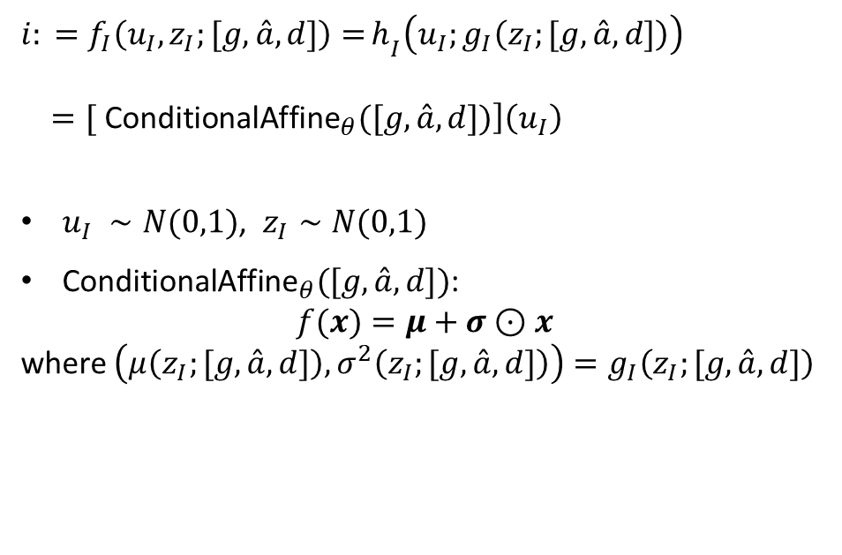
Methodology -> Image
$i: =f_{I}\left({u_{I}, z}_{I};[g,\overset{ˆ}{a},d]\right)=$ $h_{I}\left(u_{I};g_{I}\left(z_{I};[g,\overset{ˆ}{a},d]\right)\right)$
$=[ \left.{\text{ConditionalAffine}}_{θ}([g,\overset{ˆ}{a},d])\right]\left(u_{I}\right)$
$u_{I} ∼N(0,1)$, $z_{I}∼N(0,1)$
${\text{ConditionalAffine}}_{θ}([g,\overset{ˆ}{a},d])$:
$$f(x)=μ+σ⊙x$$
where $\left(μ\left(z_{I};[g,\overset{ˆ}{a},d]\right),σ^{2}\left(z_{I};[g,\overset{ˆ}{a},d]\right)\right)=g_{I}\left(z_{I};[g,\overset{ˆ}{a},d]\right)$
Notes:
讲清楚
For high dimensional data, fundus image, a noise mapped via shallow transformation is not expressive enough to account for all the unobserved factors. So we introduce two noises, u_i and z_i for it. They both and follow the normal distribution.
The noise u_i account for the low-level structure of the fundus image. It is of the same dimension as fundus image. We map it to the fundus image through an affine transformation h_i. Another noise z_i accounts for the high- level structure of the fundus image. We connect it to the shallow transformation h_i with a decoder g_i. The decoder g_i predicts the parameters for the affine transformation based on the noise z_i and the parent variables. In this way, we map the noises to the fundus image.
How do we map back to the noises. we introduce an ecoder e_i to variationally infer the noise $z_{I}$ based on the fundus image. Then the z_i go through the decoder g_i to determine the parameters in the affine transformation h_i. Then we can map the fundus image back to the noise u_i.

Slide 16
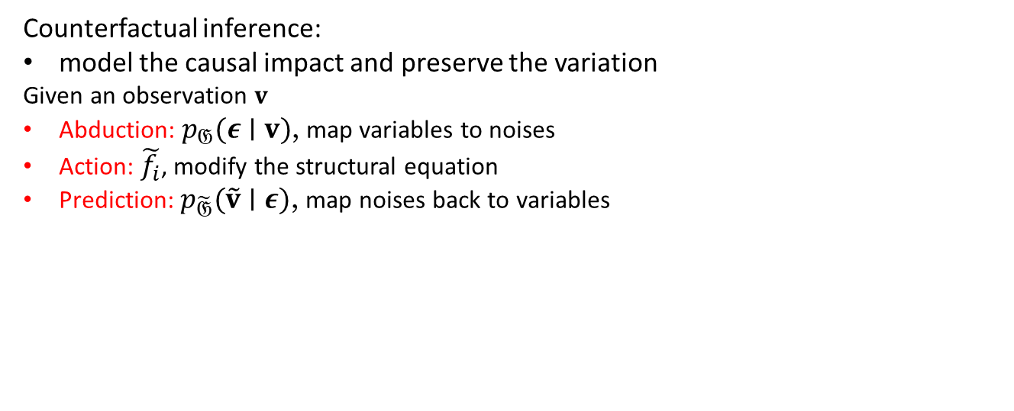
Methodology -> Counterfactual inference
Counterfactual inference:
model the causal impact and preserve the variation
Given an observation $v$
Abduction: $p_{𝔊}(ε∣v)$, map variables to noises
Action: $\tilde{f_{i}}$, modify the structural equation
Prediction: $p_{\tilde{𝔊}}(\tilde{v}∣ε)$, map noises back to variables
Fig 9: custom DSCM
Notes:
Counterfactual inference j解释
Concretely in the custom DSCM, abduction we the inverted structural equation to infer the exogenous noise in yellow. Note specifically for exogenous noise z_i, we use an encoder to varitiaonlly infer it.

Slide 17
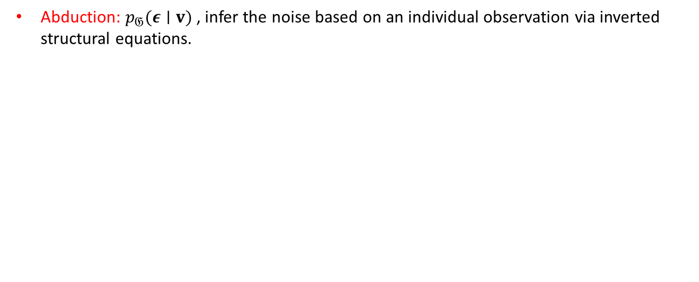
Methodology -> Counterfactual inference
Abduction: $p_{𝔊}(ε∣v)$, infer the noise based on an individual observation via inverted structural equations.
Fig 11: abduction
Notes:
Concretely in the custom DSCM, abduction we the inverted structural equation to infer the exogenous noise in yellow. Note specifically for exogenous noise z_i, we use an encoder to varitiaonlly infer it.

Slide 18
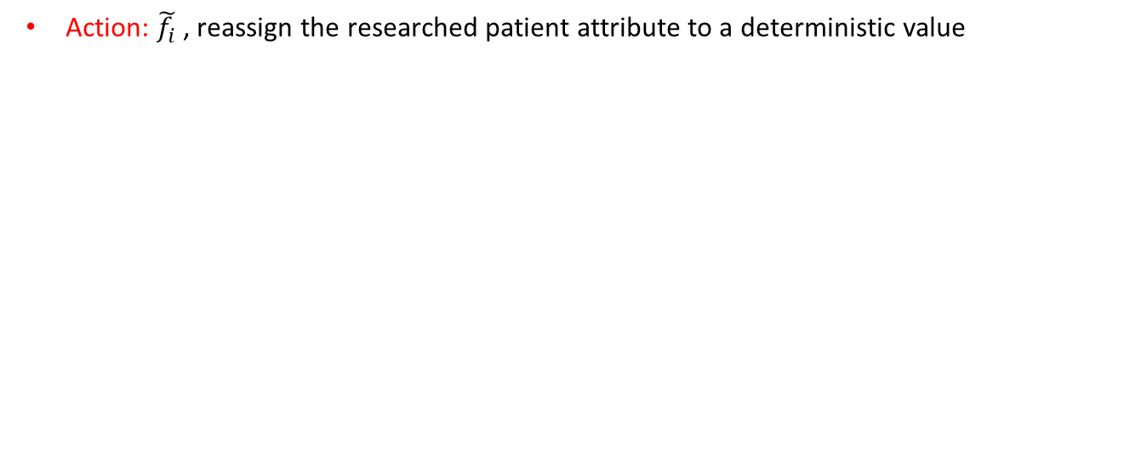
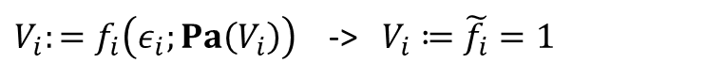
Methodology -> Counterfactual inference
Action: $\tilde{f_{i}}$, reassign the researched patient attribute to a deterministic value
$V_{i}:=f_{i}\left(ε_{i};Pa\left(V_{i}\right)\right)$ -> $V_{i}≔\tilde{f_{i}}=1$
Fig 12: causal DAG after action
Fig 13: action
Notes:
Action, for example, to research on the causal relationship between diabetes status and fundus images. So we reassign a deterministic value to the structural equation for the diabetes status. From the modified causal DAG, we can see that the causal relationship between diabetes status and fundus images is no longer influenced by the confounders gender and age.

Slide 19
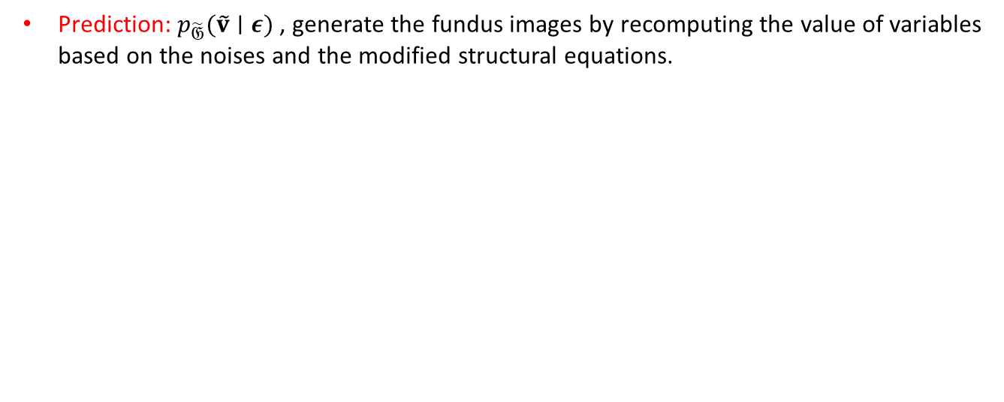
Methodology -> Counterfactual inference
Prediction: $p_{\tilde{𝔊}}(\tilde{v}∣ε)$, generate the fundus images by recomputing the value of variables based on the noises and the modified structural equations.
Fig 14: prediction
Notes:
Prediction, we follow the structural equations mapping from the exogenous noises to the variables to recompute the value of the variables.
Note z_i encode the high-level structure of the fundus image, we hope to utilize such information in the prediction to generated fundus images. So that the implicit patterns in the fundus images can represent itself on the generated funds imags.

Slide 20
Experiment and results -> Dataset
Dataset | Image Number | Participant Number
Train | 13001 | 1796
Validation | 2976 | 409
Test | 5923 | 819
Patient Attributes
Gender
Diabetes status
Age range[40, 80]
Fundus Image
Notes:
We use the Maastricht Dataset and random split it into train, validation, and test set. Each observation have gender, diabetes status, age and fundus image. The age ranges from 40 years old to 80 years old.

Slide 21
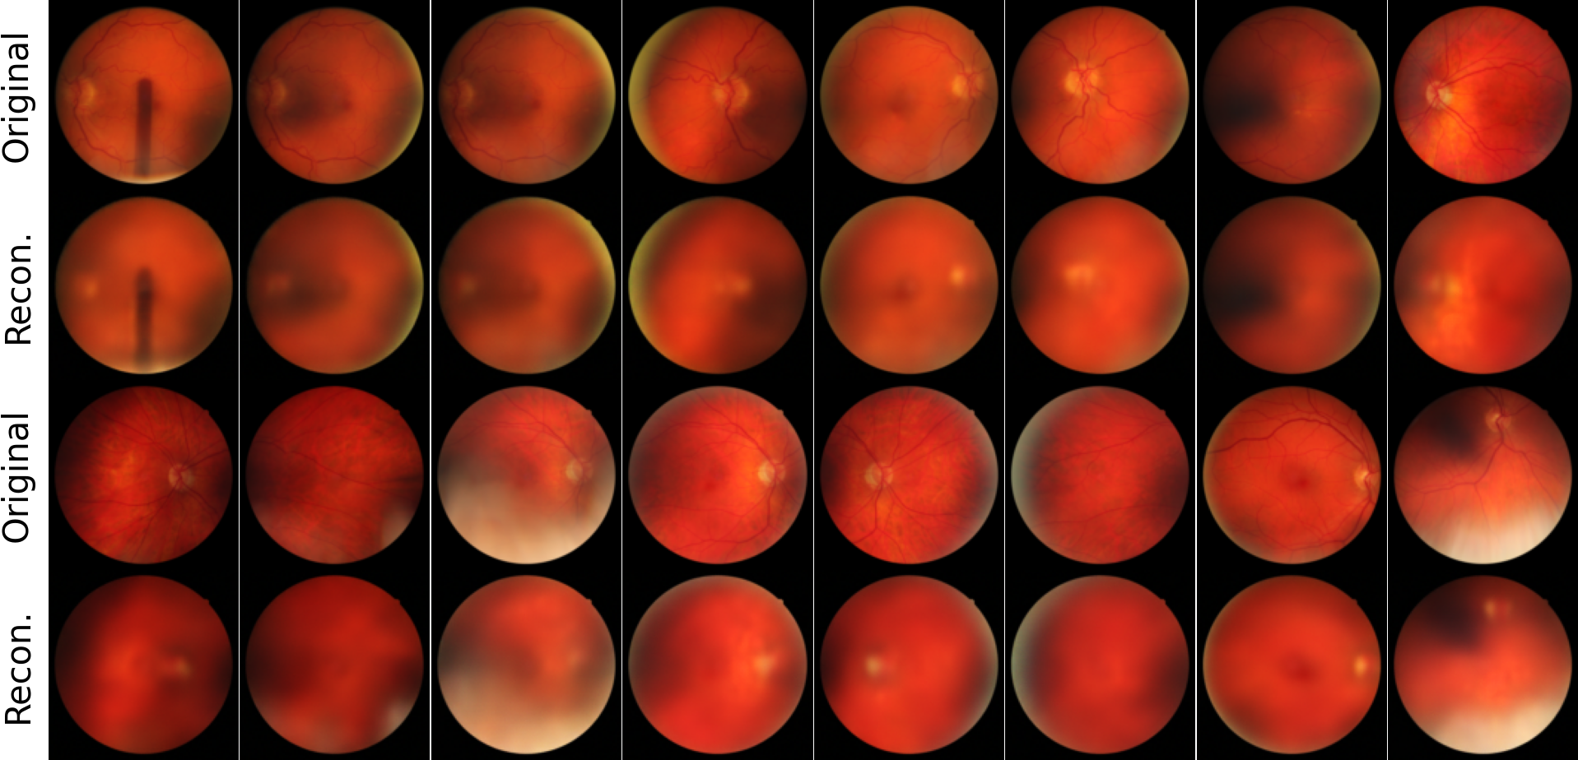
Experiment and results -> Image Reconstruction
The reconstructed images indicate the expressiveness of the noise $z_{I}$
Fig 15: Reconstructed fundus image
Fig 16: Image reconstruction
Notes:
Then let’s move to the experiment results. Firstly, we evaluate the representation of the exogenous noise z_I by image reconstruction. As shown in the workflow at bottom right, we variationally infer the exogenous noise z_I, sample u_i from Normal distribution and generate the fundus images based on these two exogenous noises.
Compare the original and the reconstructed fundus images, we see that the reconstructed images are blurry overall and preserve the color, optic disc, while losing the anatomical structure like vessels, background texture.

Slide 22
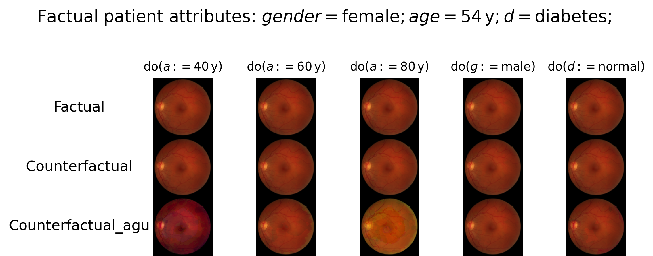
Experiment and results -> Counterfactual inference
Fig 17: Counterfactual inference on an individual
Notes:
强调 没效果的地方
Then we make counterfactual inference on the fundus image for an individual observation
Generate fundus images for an individual observation conditioned on counterfactual patient attributes
The patient is a 54 years old female with type-2 diabetes. We research on the causal relationship between age and fundus image by reassigning the age to 40 years old, 60 years old, and 80 years old.
For the causal relationship between gender and fundus image, we reassign the gender to opposite male. For the causal relationship between diabetes status and fundus image, we reassign the diabetes status to opposite normal.
The first row is the factual fundus image, the second row is the counterfactual inferred fundus image. As the difference is slight, I augment the counterfactual inferred fundus image by multiplying the difference by 15 and add back to the factual fundus image in the third row. And we plot the heatmap of the difference per RGB channel in the last three rows.
As we can see. The generated fundus image is more red under younger age and is more yellow under older age. This is because the pixel value on red and green channel is increasing and pixel value on blue channel is decreasing as the age increases. We can say aging causes the fundus image to be slightly yellow. However, the generated funds images under counterfactual condition gender and diabetes don’t have significant changes.

Slide 23
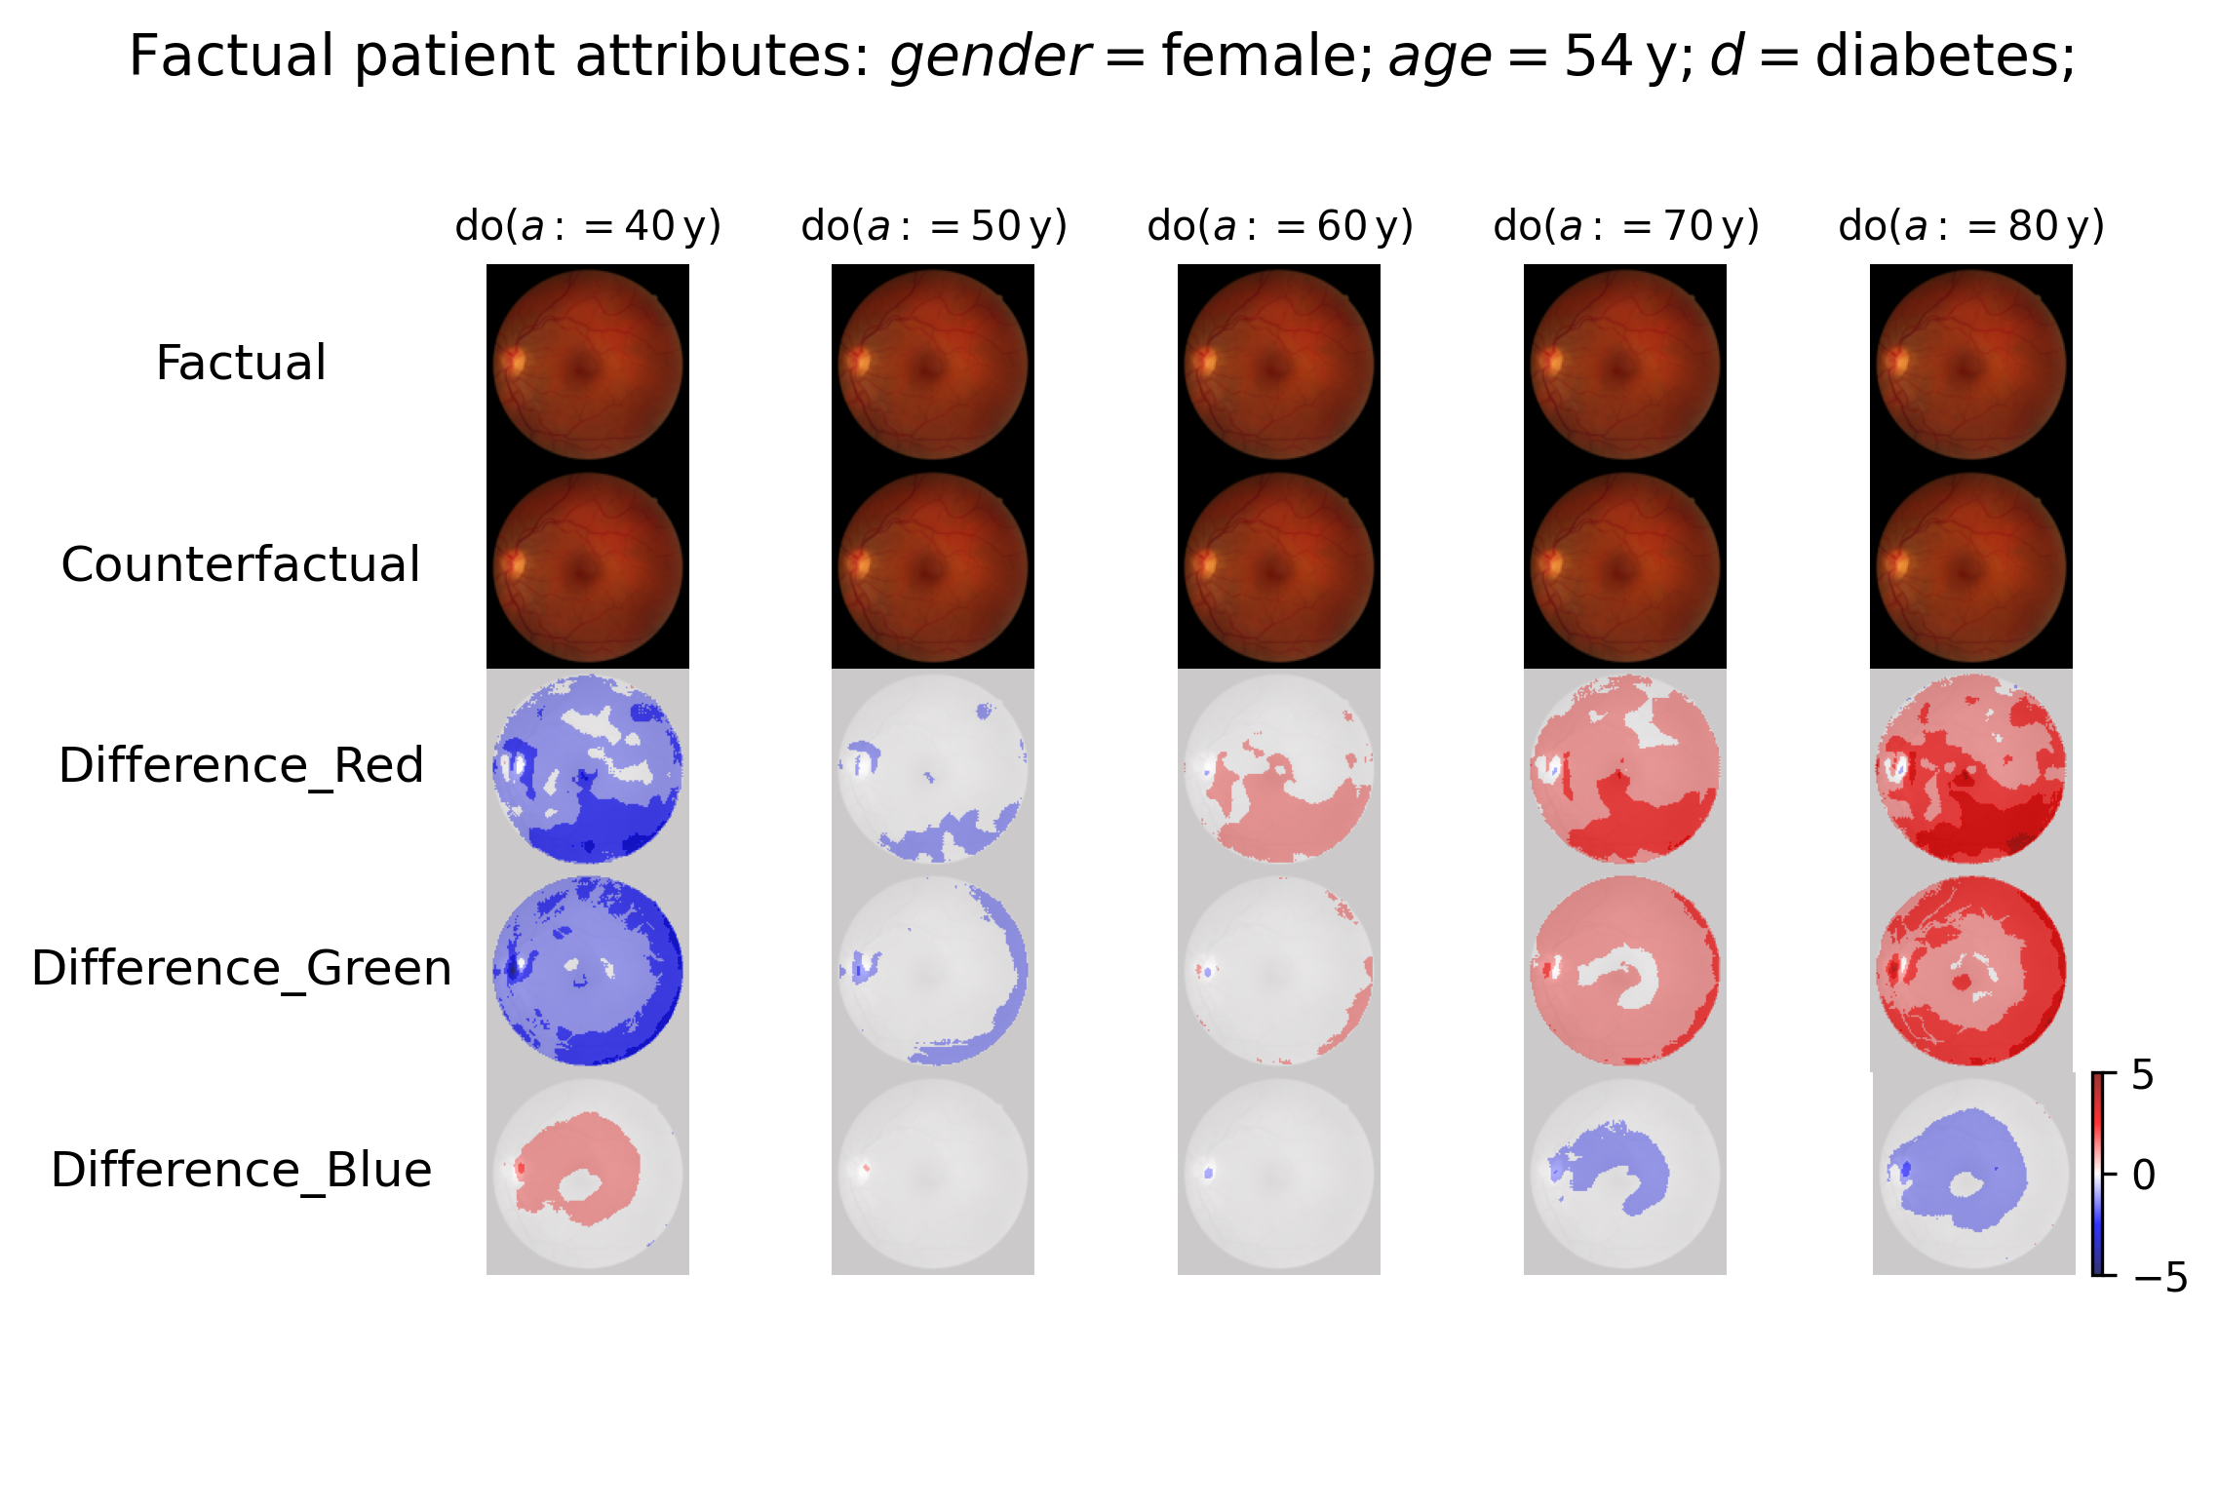
Fig 18: Counterfactual inference on original fundus image
Notes:
The patient is a 54 years old female with type-2 diabetes. We research on the causal relationship between age and fundus image by reassigning the age to 40 years old, 60 years old, and 80 years old.
For the causal relationship between gender and fundus image, we reassign the gender to opposite male. For the causal relationship between diabetes status and fundus image, we reassign the diabetes status to opposite normal.
The first row is the factual fundus image, the second row is the counterfactual inferred fundus image. As the difference is slight, I augment the counterfactual inferred fundus image by multiplying the difference by 15 and add back to the factual fundus image in the third row. And we plot the heatmap of the difference per RGB channel in the last three rows.
As we can see. The generated fundus image is more red under younger age and is more yellow under older age. This is because the pixel value on red and green channel is increasing and pixel value on blue channel is decreasing as the age increases. We can say aging causes the fundus image to be slightly yellow. However, the generated funds images under counterfactual condition gender and diabetes don’t have significant changes.

Slide 24
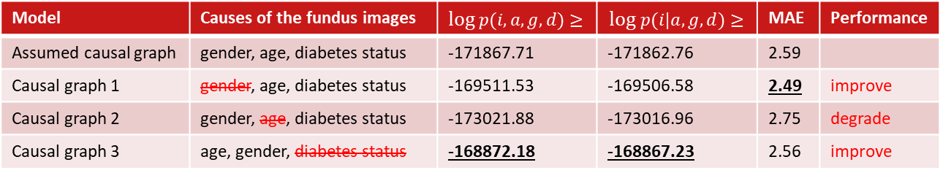
Experiment and results -> Sensitivity Analysis
Compare DSCMs based on alternative causal graphs
Fig 19: Alternative causal graph 1
Fig 20: Alternative causal graph 2
Fig 21: Alternative causal graph 3
Model | Causes of the fundus images | $log$ $p(i,a,g,d)≥$ | $$log p(i|a,g,d)≥$$ | MAE | Performance
Assumed causal graph | gender, age, diabetes status | -171867.71 | -171862.76 | 2.59
Causal graph 1 | gender, age, diabetes status | -169511.53 | -169506.58 | 2.49 | improve
Causal graph 2 | gender, age, diabetes status | -173021.88 | -173016.96 | 2.75 | degrade
Causal graph 3 | age, gender, diabetes status | -168872.18 | -168867.23 | 2.56 | improve
Notes:
目的 不是探索 是解释为什么不好，多加一页论证
To explore why we cannot make reasonable counterfactual inference on gender and diabetes status, we implement a sensitivity analysis on the assumed causa DAG.
We change the assumption on the causes of the fundus images and compare its evidence lower bound log likelihood and mean absolute error per pixel. We can see the alternative causal DAGs in the above. The bold ones are the best performance. We can see that drop gender or diabetes status from cause of the fundus images improve the performance while drop age from cause of the fundus images degrades the performance.
We give our explanation. The expressive ness of our custom DSCM is limited to color. And age has a causal effect on the fundus images color while gender and diabetes status have a causal effect more on the anatomical structure of the fundus images.
So exclusion of gender or diabetes status improve the performance while exclusion of age degrades the performance.

Slide 25
Experiment and results -> Counterfactual inference
Fig 17: Counterfactual inference on an individual
Notes:
Then we make counterfactual inference on the fundus image for an individual observation
Generate fundus images for an individual observation conditioned on counterfactual patient attributes
The patient is a 54 years old female with type-2 diabetes. We research on the causal relationship between age and fundus image by reassigning the age to 40 years old, 60 years old, and 80 years old.
For the causal relationship between gender and fundus image, we reassign the gender to opposite male. For the causal relationship between diabetes status and fundus image, we reassign the diabetes status to opposite normal.
The first row is the factual fundus image, the second row is the counterfactual inferred fundus image. As the difference is slight, I augment the counterfactual inferred fundus image by multiplying the difference by 15 and add back to the factual fundus image in the third row. And we plot the heatmap of the difference per RGB channel in the last three rows.
As we can see. The generated fundus image is more red under younger age and is more yellow under older age. This is because the pixel value on red and green channel is increasing and pixel value on blue channel is decreasing as the age increases. We can say aging causes the fundus image to be slightly yellow. However, the generated funds images under counterfactual condition gender and diabetes don’t have significant changes.

Slide 26
Experiment and results -> Sensitivity Analysis
Why DSCM fails to generate fundus images conditioned on gender and diabetes status
DSCM has expressiveness on color but not on anatomical structure.
Patient attributes | Causal impact on fundus image | Counterfactual inference | Model performance after exclusion
Age | Color | Yes | Degrade
Gender | Anatomical structure | No | Improved
Diabetes status | Anatomical structure | No | Improved
Notes:
目的 不是探索 是解释为什么不好，多加一页论证
To explore why we cannot make reasonable counterfactual inference on gender and diabetes status, we implement a sensitivity analysis on the assumed causa DAG.
We change the assumption on the causes of the fundus images and compare its evidence lower bound log likelihood and mean absolute error per pixel. We can see the alternative causal DAGs in the above. The bold ones are the best performance. We can see that drop gender or diabetes status from cause of the fundus images improve the performance while drop age from cause of the fundus images degrades the performance.
We give our explanation. The expressive ness of our custom DSCM is limited to color. And age has a causal effect on the fundus images color while gender and diabetes status have a causal effect more on the anatomical structure of the fundus images.
So exclusion of gender or diabetes status improve the performance while exclusion of age degrades the performance.

Slide 27
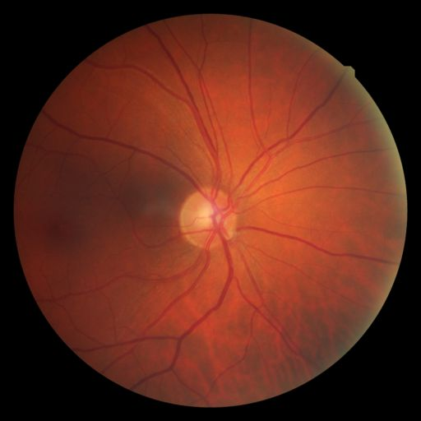
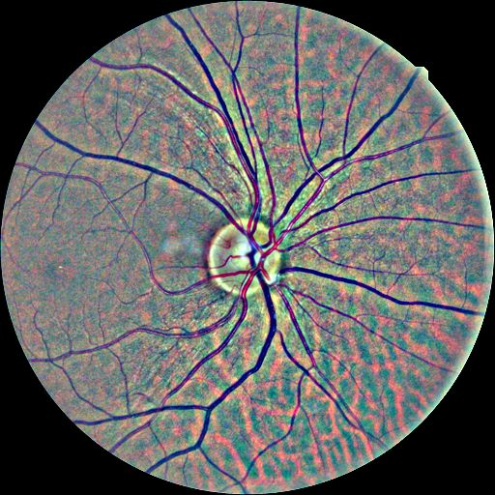
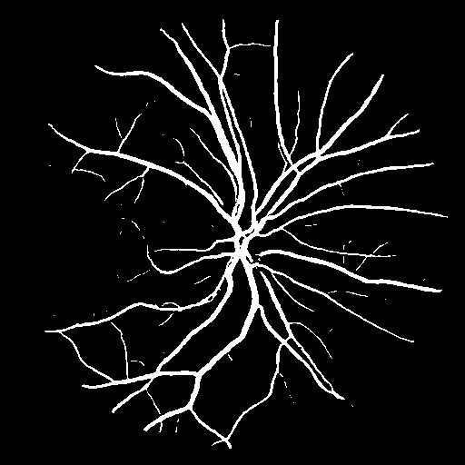
Experiment and results -> Image preprocessing
Fig 22: original fundus image
Fig 23: contrast-enhanced fundus image
Fig 24: vessel mask of fundus image
Notes:
To improve the expressiveness of our custom DSCM on the anatomical structure. We train the DSCM on preprocessed fundus images.
The contrast-normalized fundus images highlight the vessel and optic disc. And the vessel mask highlights the vessel shape.

Slide 28
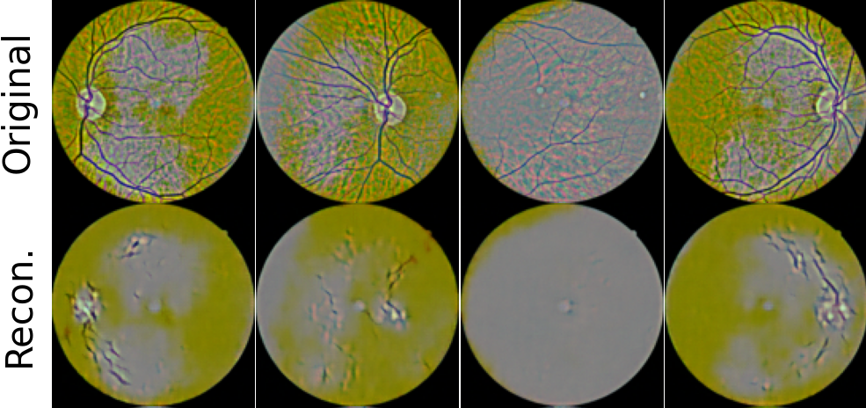
Experiment and results -> Image preprocessing
Fig 25: Reconstructed contrast-enhanced fundus image
Notes:
For the contrast normalized fundus images, the reconstructed images preserve the optic disc and truncated vessels from the optic disc.

Slide 29
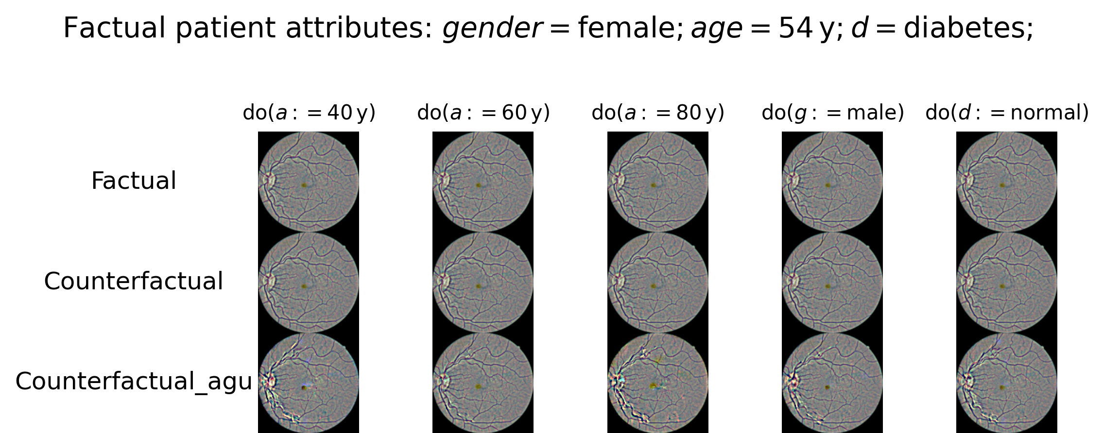
Experiment and results -> Image preprocessing
Fig 26: Counterfactual inference on contrast-enhanced fundus image
Notes:
The patient is a 54 years old female with type-2 diabetes. We research on the causal relationship between age and fundus image by reassigning the age to 40 years old, 60 years old, and 80 years old.
For the causal relationship between gender and fundus image, we reassign the gender to opposite male. For the causal relationship between diabetes status and fundus image, we reassign the diabetes status to opposite normal.
The first row is the factual fundus image, the second row is the counterfactual inferred fundus image. As the difference is slight, I augment the counterfactual inferred fundus image by multiplying the difference by 15 and add back to the factual fundus image in the third row. And we plot the heatmap of the difference per RGB channel in the last three rows.
As we can see. The generated fundus image is more red under younger age and is more yellow under older age. This is because the pixel value on red and green channel is increasing and pixel value on blue channel is decreasing as the age increases. We can say aging causes the fundus image to be slightly yellow. However, the generated funds images under counterfactual condition gender and diabetes don’t have significant changes.

Slide 30
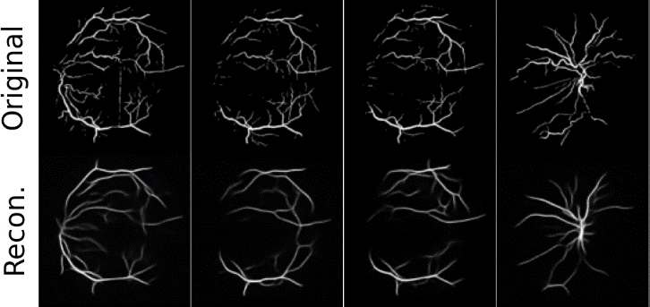
Experiment and results -> Image preprocessing
Fig 27: Reconstructed vessel mask of fundus image
Notes:
For the vessel mask of the fundus images, the reconstructed images preserve the shape of the vessel trunk and lose the tiny vessel branch.

Slide 31
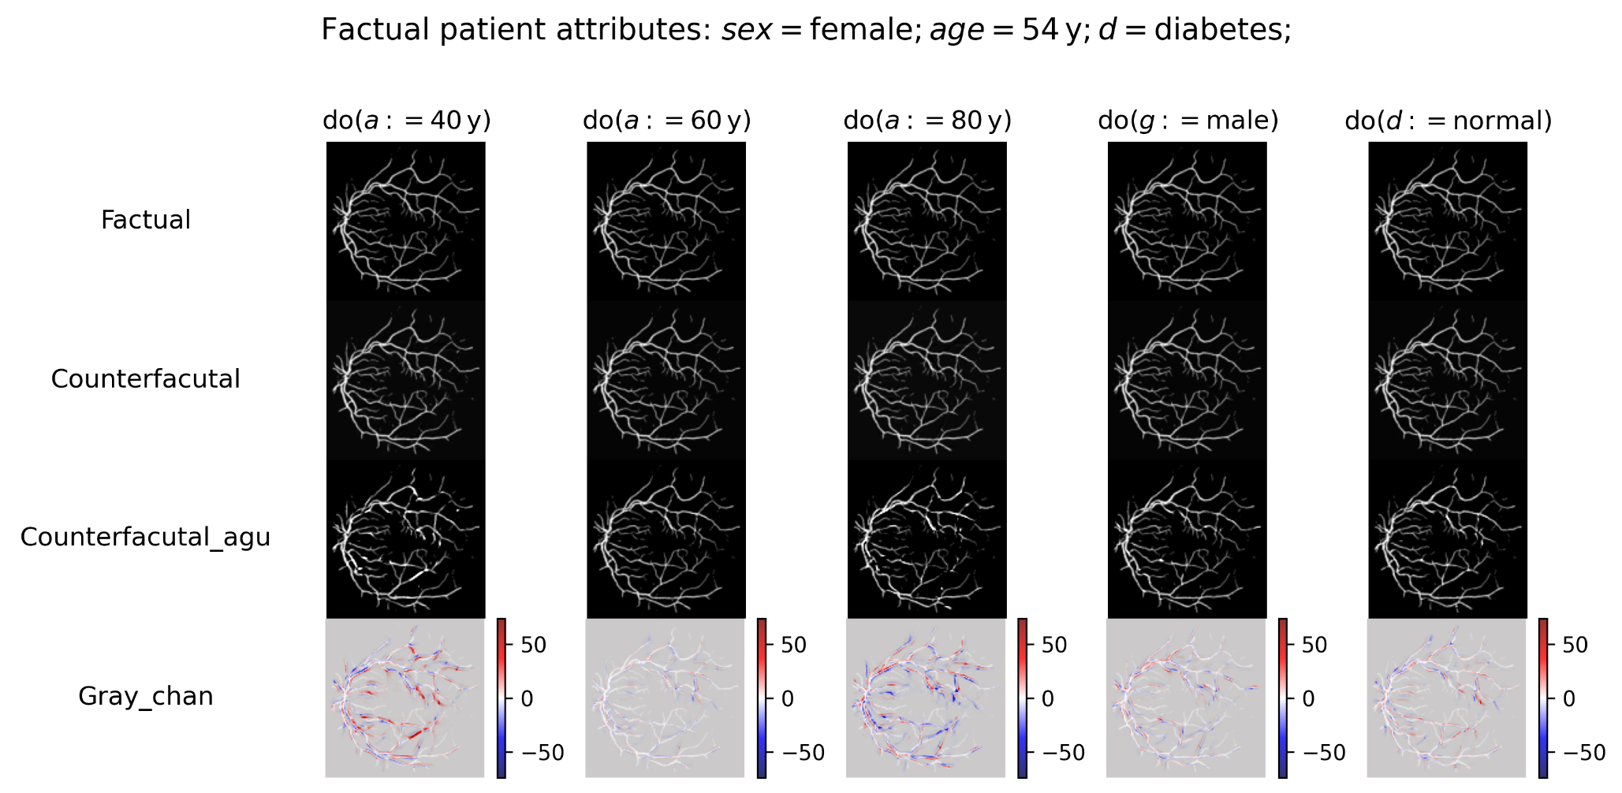
Experiment and results -> Image preprocessing
Fig 28: Counterfactual inference on vessel mask of fundus image
Notes:
The counterfactual inferred images have partially enhanced and partially degraded vessel trunk under any counterfactual condition. And they do not show any reasonable and informative change patterns.

Slide 32
Conclusion
The custom DSCM has expressiveness on the fundus image color but not on anatomical structure.
Aging causes the fundus images to be slightly more yellow
Image preprocessing has limited expressiveness improvement on anatomical structure of fundus images.
Notes:
Based on the experiment results, we make our conclusion.
As a result, it can generate reasonable fundus images under counterfactual age but not under counterfactual gender and diabetes status.
can be used to explain the black box in the neural networks to predict age with the fundus images.

Slide 33
Future work
More expressive causal models supporting counterfactual inference, like ImageCFGen
Improve the fundus image quality and expand data volume.
Notes:
by filtering out the occluded and not centered on optic disc. Also

Slide 34
THE END
Thank you for watching
Shiqi Liao
Mathematics and Computer Science, Data Science in Engineering, Data Mining

Slide 35
Background -> limitations in explanation
Confounding between patient attributes
Fundus image appearance is variant
Fig 5: Causal graph
Fig 6: variant fundus image appearance
Notes:
Confound means that When we study the correlation between two independent variables, there is a common cause on them, this common cause falsely demonstrate the correlation. For example, aging causes people to have diabetes and it changes the fundus image appearance. So are deep learning predicting the diabetes by the correlation via age or the causal impact from diabetes on fundus image?
A generative model on correlation cannot solve this problem.
Another limitation is that fundus image appearance is variant. Everyone has different color, location of optic disc and vessel shape. So we cannot tell whether the difference between two generated fundus images is for the variation or the conditioned patient attribute.

Slide 36
Methodology -> Image
Why VAE:
It has latent representation as the noise(x GAN)
The computational complexity is affordable(x NF)
Easy to implement conditional generative model with multiple conditions(x Diffusion)
Alternatives:
ImageCFGen: it also adopts Variational inference to encode the fundus image. However, it does not have an ideal discriminator.
Diffusion-SCM: use the anti-causal predictor to guide the reverse diffusion process to generate fundus image conditioned on a patient attribute. However, the predictor is still based on correlation so it suffers confoundings.
Notes:
For high dimensional data, fundus image, a noise mapped via shallow transformation is not expressive enough to account for all the unobserved factors. So we introduce two noises, u_i and z_i for it.
The noise u_i account for the low-level structure in the fundus image. It is of the same dimension as fundus image and follows the normal distribution. We map it to the fundus image through a affine transformation and a fixed preprocessing transformation
we adopt a structural equation combing a shallow affine transform $h_{I}$ and a deep variational autoencoder $e_{I}$ and $g_{I}$. It has two exogenous noises $u_{I}$and $z_{I}$.
In the shallow affine transform $h_{I}$, we map the fundus image to the exogenous noises $u_{I}$of the same dimension via an affine transformation. And the parameters $μ+σ$(mu and sigma) is predicted by a decoder $g_{I}$ with the input of the patient attributes and another exogenous noise $z_{I}$. The exogenous noises $z_{I}$ also follows the normal distribution.
Recall that the structural equation should be invertible. Now we can map from the exogenous noises to the fundus image so far but can not map from the fundus image to the exogenous noises. So we introduce an encoder $e_{I}$ to variationally infer the exogenous noise $z_{I}$. We set the exogenous noise $z_{I}$ to a low dimension and expect it to encode the high-level structure of the fundus images.
重点 如何bijective

Slide 37
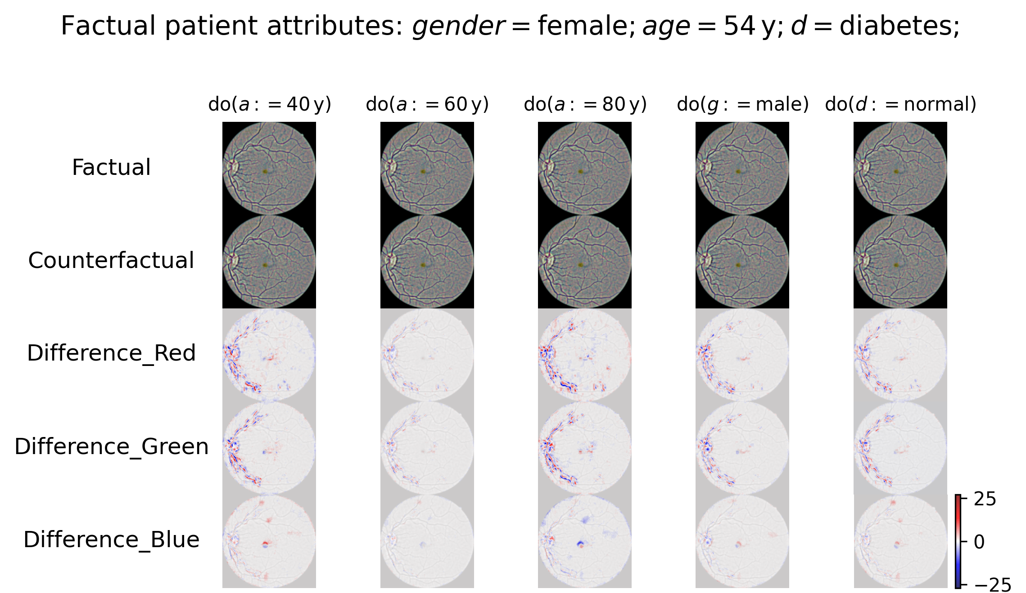
Fig 32: Counterfactual inference on an individual
Notes:
The patient is a 54 years old female with type-2 diabetes. We research on the causal relationship between age and fundus image by reassigning the age to 40 years old, 60 years old, and 80 years old.
For the causal relationship between gender and fundus image, we reassign the gender to opposite male. For the causal relationship between diabetes status and fundus image, we reassign the diabetes status to opposite normal.
The first row is the factual fundus image, the second row is the counterfactual inferred fundus image. As the difference is slight, I augment the counterfactual inferred fundus image by multiplying the difference by 15 and add back to the factual fundus image in the third row. And we plot the heatmap of the difference per RGB channel in the last three rows.
As we can see. The generated fundus image is more red under younger age and is more yellow under older age. This is because the pixel value on red and green channel is increasing and pixel value on blue channel is decreasing as the age increases. We can say aging causes the fundus image to be slightly yellow. However, the generated funds images under counterfactual condition gender and diabetes don’t have significant changes.

Slide 38
Fig 43: Counterfactual inference on vessel mask of fundus images
Notes:
The counterfactual inferred images have partially enhanced and partially degraded vessel trunk under any counterfactual condition. And they do not show any reasonable and informative change patterns.

